Slide 1
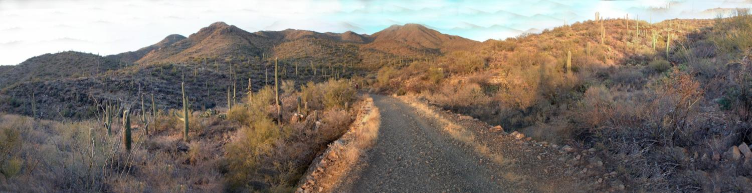
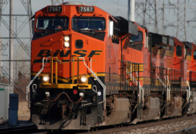
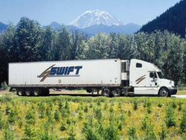
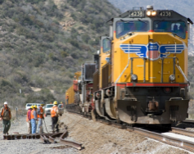

Proposed mag freight study and Interstate 11
Joint Planning Advisory Committee
April 20, 2010

Slide 2
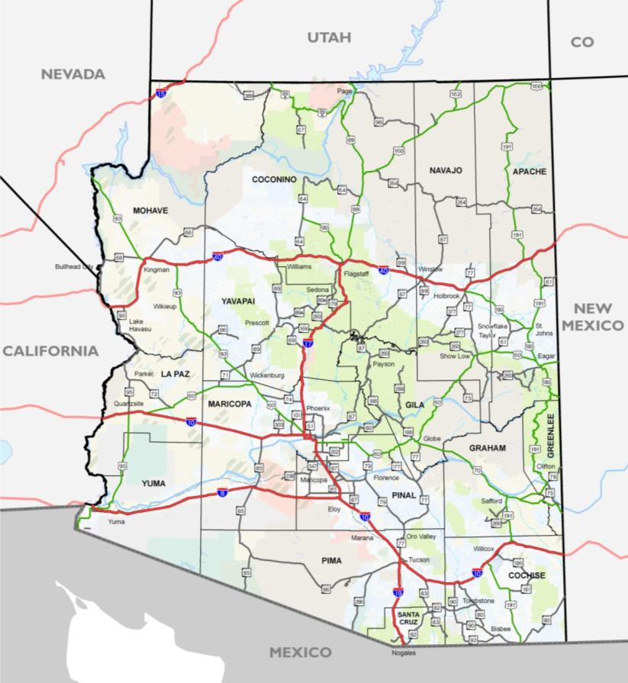
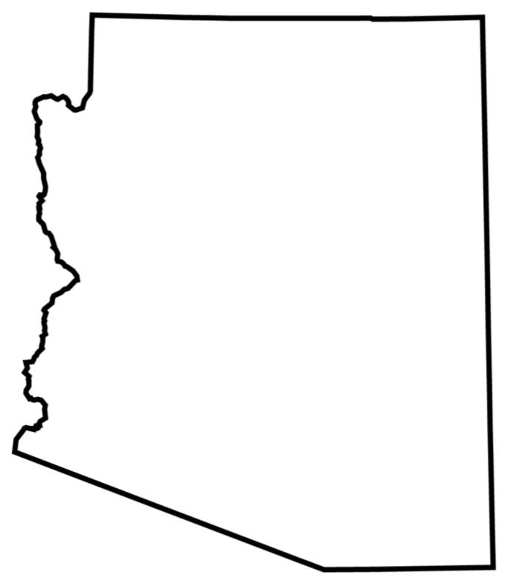

Bordering States
COG/MPO DISCUSSIONS
ST. GEORGE:
Scottsdale of Utah?
Tourism and Recreation
California Population:
60 M by 2050!
Out of land!
Las
Vegas
Navajo Nation relates more to New Mexico
Grand Canyon TOURISM
17
Bedroom community
I-17 Extension?
25
High-tech
industry along
I-25
People
Businesses
Second homes
Tourists
Commercial Vehicles
Eager/ Springerville provide shopping/ services to Western New Mexico
LAND BRIDGE
agriculture
ECONOMIC DEVELOPMENT
Mexico’s fastest growing states are in the north (Sonora, Chihuahua, and Nuevo Leon)
Transportation infrastructure
Key CONNECTIONS to Guaymas, Hermosillo,
Punta Colonet
maquiladoras

Slide 3


Arizona
COG/MPO DISCUSSIONS
Commercial Trucking
  Distribution throughout Southwest USA
  Elevation in Central Arizona (SR-89/SR-69)
  US-95/SR-95 Corridor
  CANAMEX
Natural Resources
  Copper in Safford Area
Emerging Industries
  Welton Oil Refinery
  Warehousing
Sun Corridor Megaregion
  Prescott
  Phoenix
  Tucson
Recreation and Tourism
R e c r e a t i o n
Pearce
Ferry
Growth Limitations
In-migration
Western CANAMEX?
R e c r e a t i o n
Population will double
Copper mining
Agrarian → Industrial
Incoming Commerce!
Informal Truck Bypasses
Warehousing/Distribution Hub

Slide 4
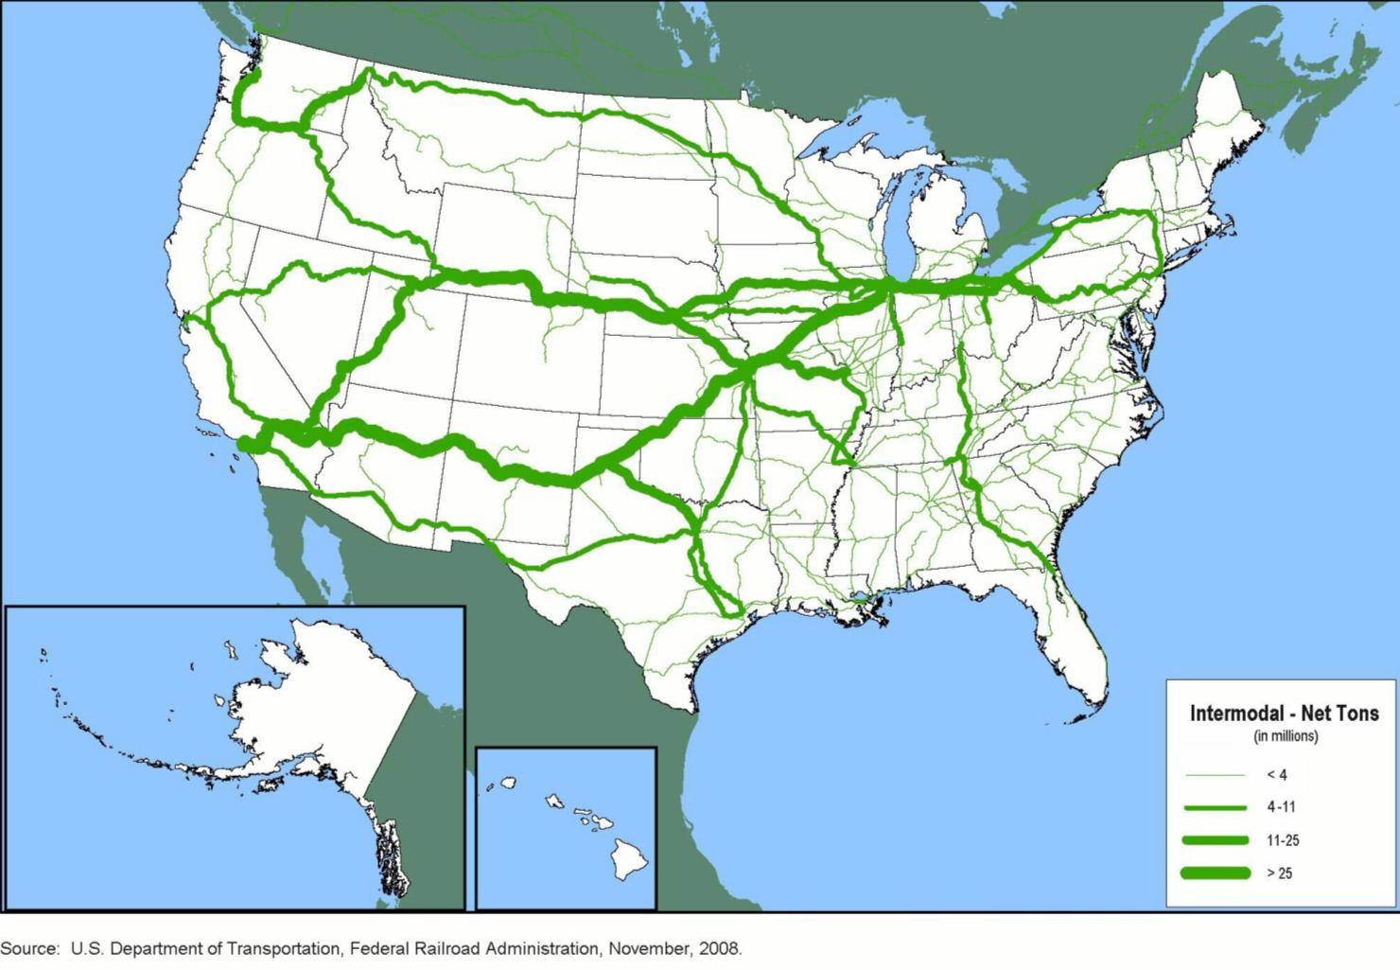
2006 Tonnage of Trailer-on-Flatcar and Container-on-Flatcar Intermodal Moves

Slide 5
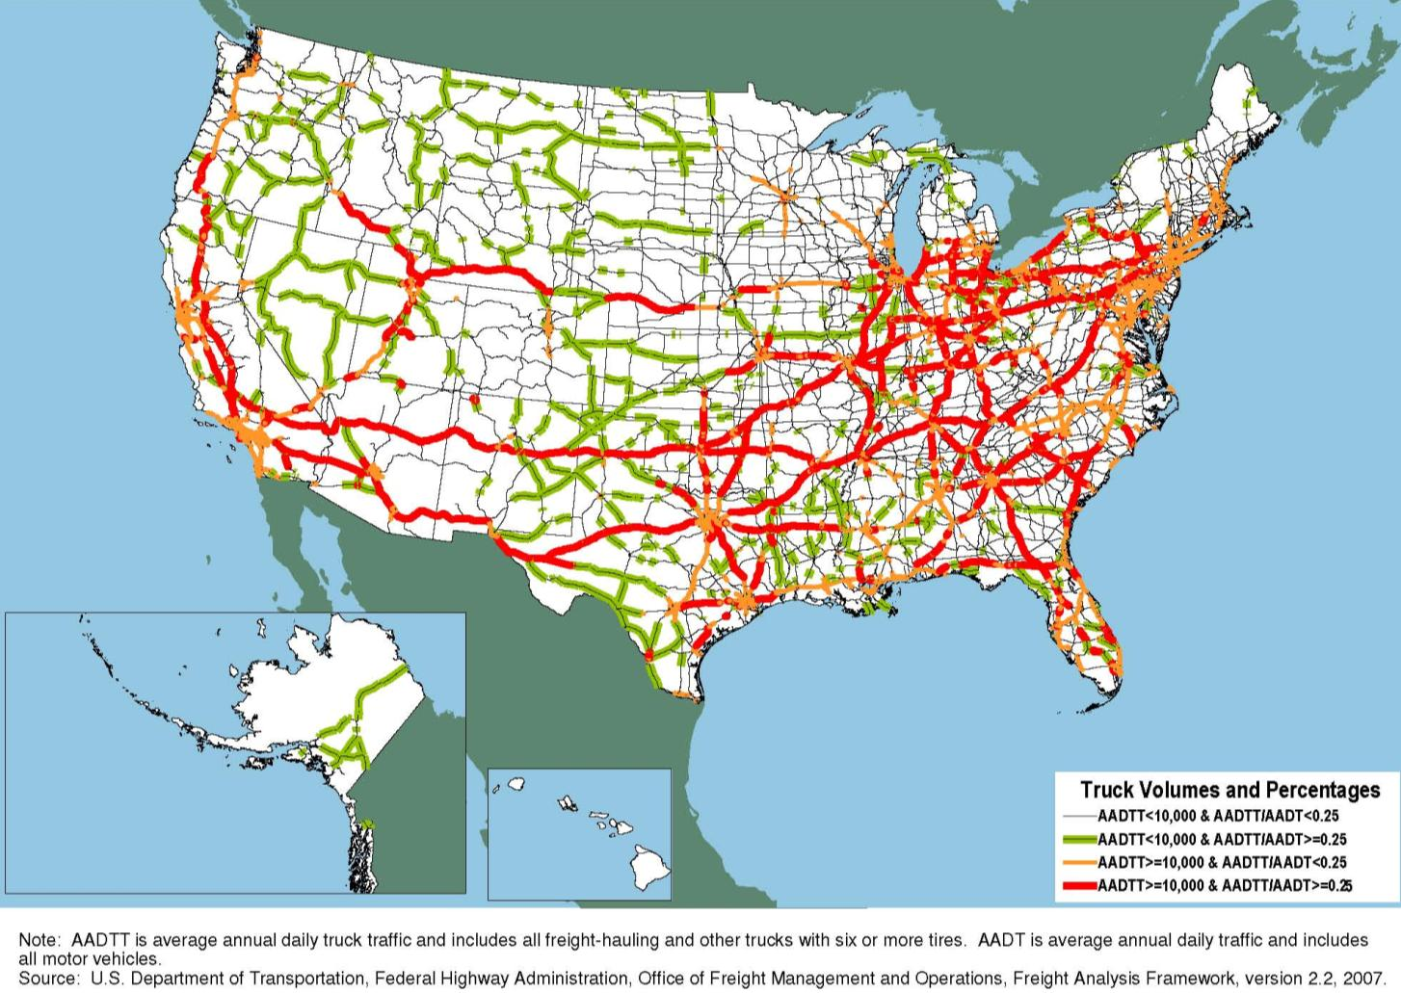
2035 Major Truck Routes on the National Highway System

Slide 6
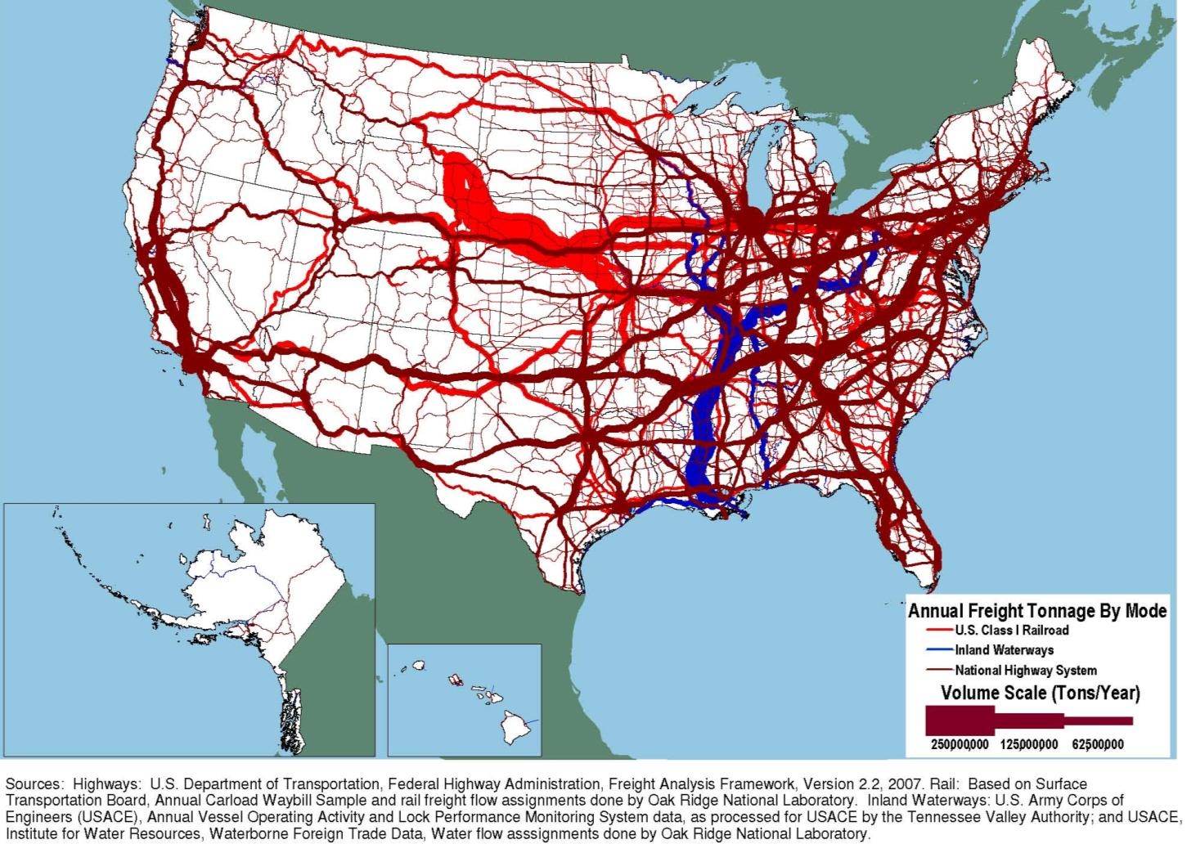
2002 Tonnage on Highways, Railroads and Inland Waterways

Slide 7
2002 Ton-Miles of Truck Shipment

Slide 8
2007 Port Activities
World Ports
(Thousands of full and empty TEUs)
U.S.A. Ports
(Thousands of full and empty TEUs)
Punta Colonet
6 million TEU
By 2030
Punta Colonet
1 million TEU
Opening

Slide 9
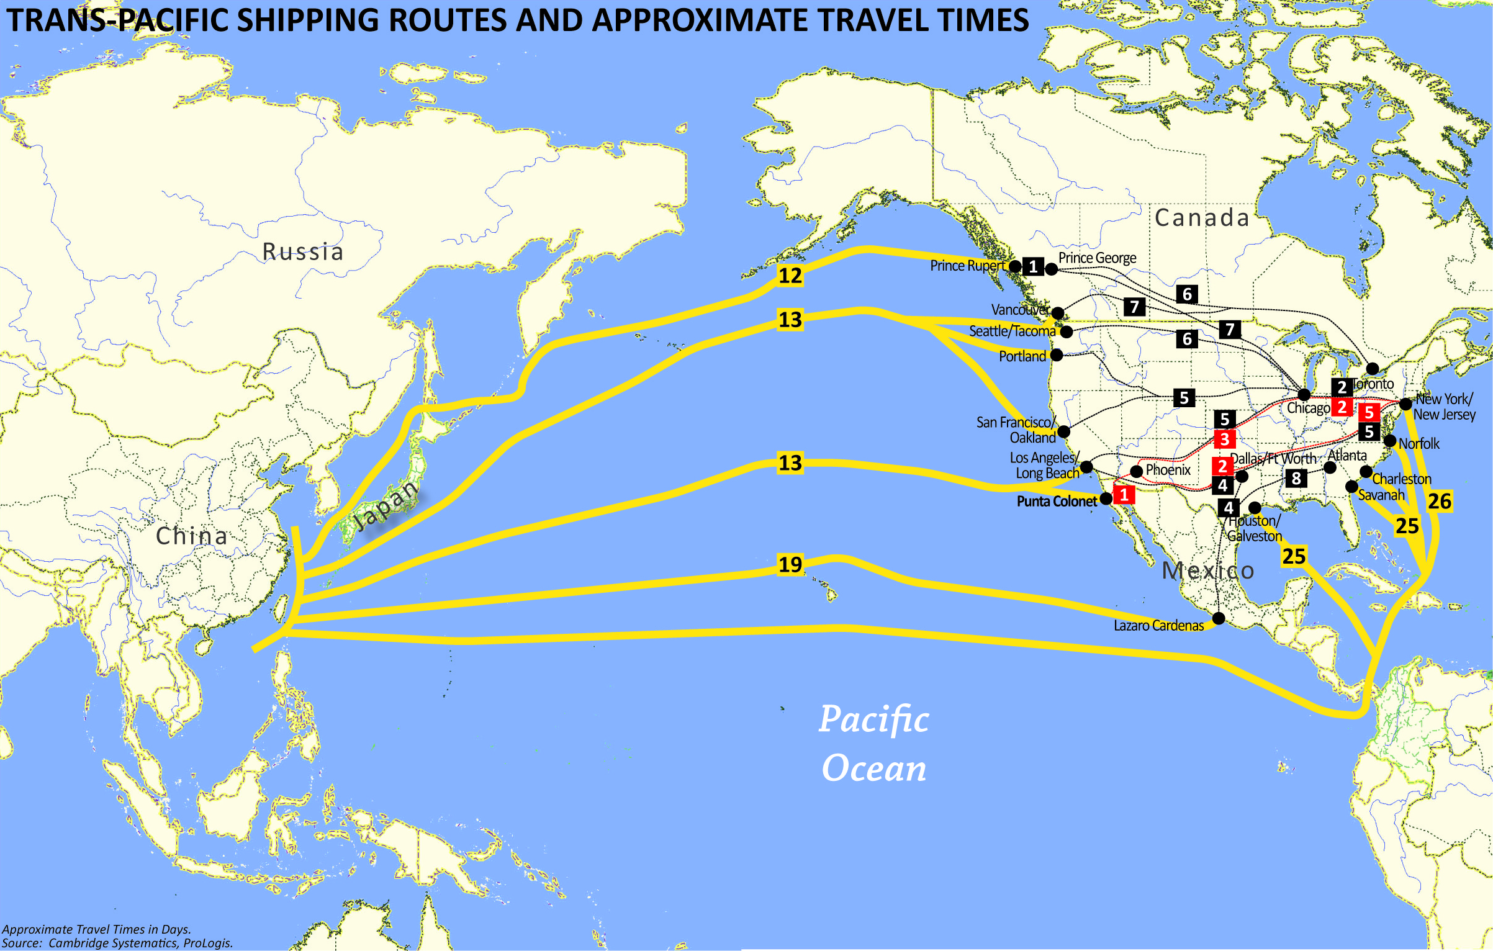

Slide 10
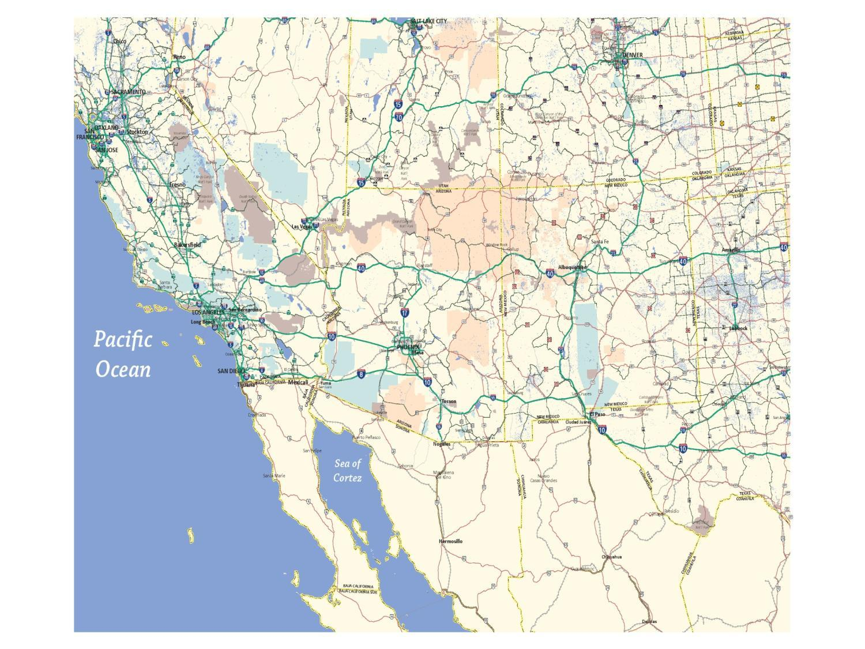
Inland Port Opportunities
Union Pacific
BNSF Railway
BNSF Railway
KINGMAN
Hassayampa Corridor
PHOENIX
YUMA
TUCSON
Punta Colonet
Union Pacific
Guymas

Slide 11
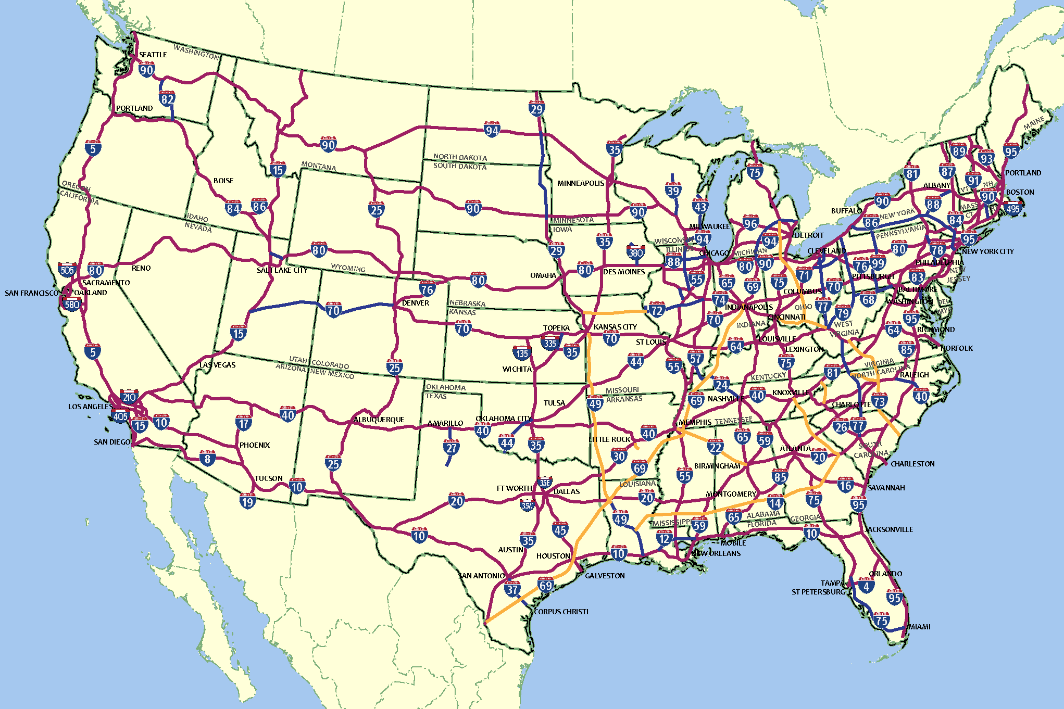
Interstate Highway System

Slide 12
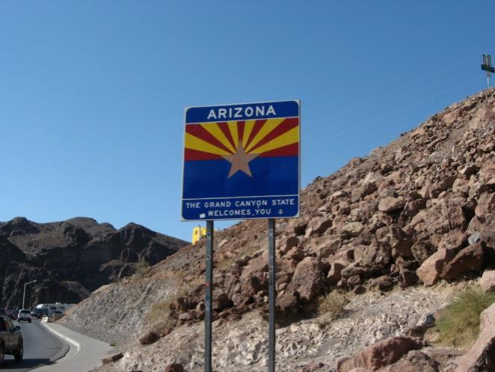
Gaps and Issues
Boulder City Bypass
Bridging the Colorado River at Hoover Dam
US-93 widening
Extension into Phoenix
  Along Grand Avenue?
  Bypass Phoenix?
US-93, South of Hoover Dam.

Slide 13
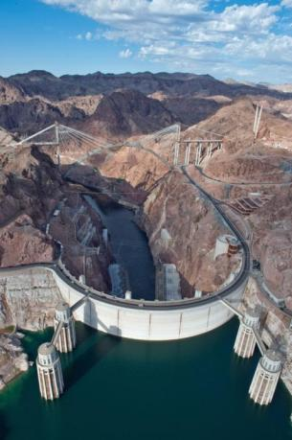
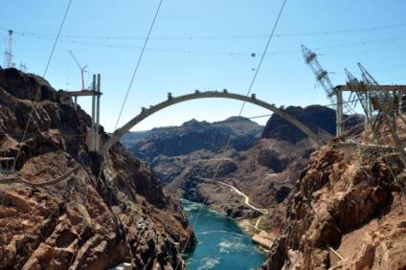






US-93/Hoover Dam Bypass
Mike O'Callaghan – Pat Tillman Memorial Bridge
Open for traffic – December 2010

Slide 14
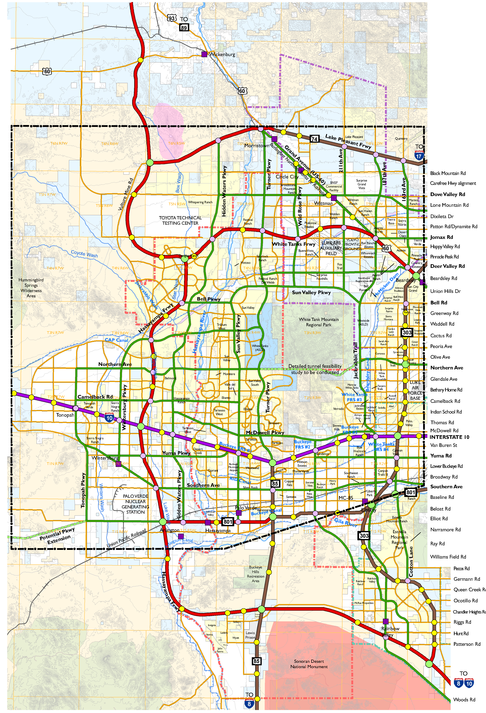
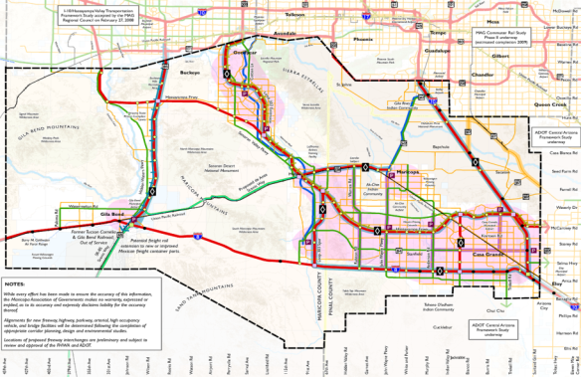

Hassayampa Framework
Accepted by the MAG Regional Council, February 2008.
Hidden Valley Framework
Accepted by the MAG Regional Council, September 2009.

Slide 15
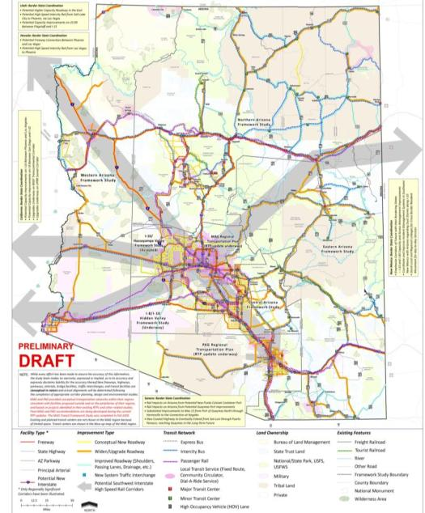

Statewide
Framework
Accepted by the State Transportation Board, January 2010.

Slide 16
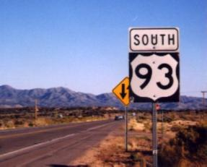
CAN-DO: The Interstate 11 Coalition
Connecting Arizona and Nevada – Delivery Opportunities
Town of Buckeye, AZ
City of Kingman, AZ
Maricopa County, AZ
Town of Wickenburg, AZ
Yavapai County, AZ
Boulder City, NV
City of Las Vegas, NV
Regional Transportation Commission of Southern Nevada
America Nevada Company
AREA Property Partners
Arizona Builder’s Alliance
Associated General Contractors Arizona
Belmont
Buckeye Valley Chamber of Commerce
Buckeye Valley Development, Inc.
Douglas Ranch
The Greenspun Company
JDM Partners
Langley Properties
Las Vegas Convention and Visitors Authority
NAIOP Southern Nevada Chapter
The Nevada Development Authority
Pulte Homes Corporation
The Sundt Companies
Swift Transportation, Inc.
Wickenburg Chamber of Commerce

Slide 17
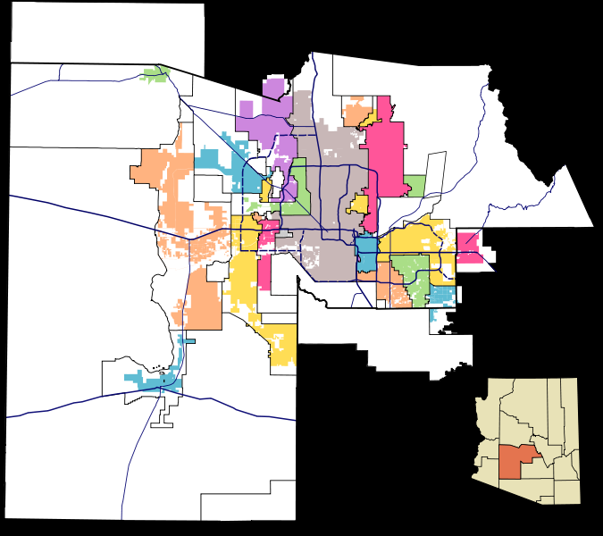
Freight Framework Study
Proposed for FY2011 Unified Planning Work Program
Tim Strow, Project Manager

Slide 18
For more information . . .
Maricopa Association of Governments
602 254-6300
Bob Hazlett
bhazlett@mag.maricopa.gov
Tim Strow
tstrow@mag.maricopa.gov

